Slide 1
ANALYSIS OF MEMBER UNDER FLEXURAL LOAD

Slide 2
Analysis of Flexural Member –Force Concept

Slide 3
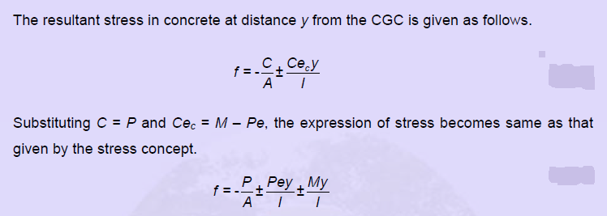

Slide 4
Analysis of Flexural Member –Load Balancing Concept

Slide 6
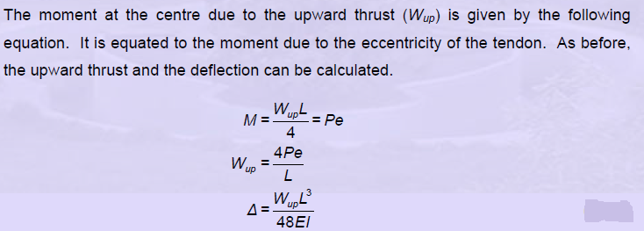
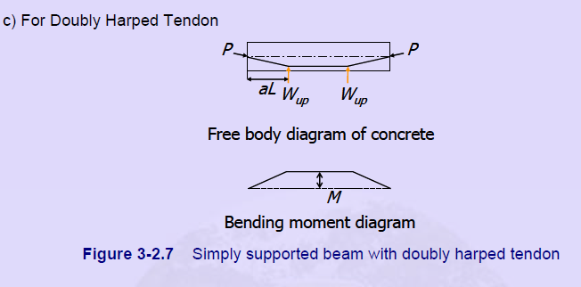

Slide 7
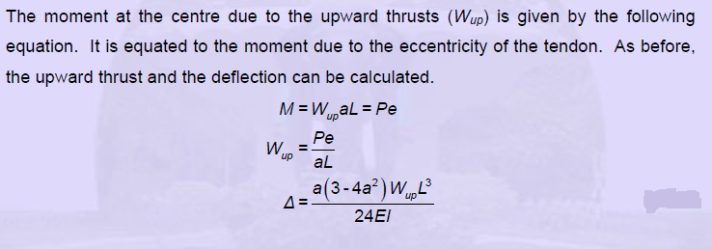

Slide 9
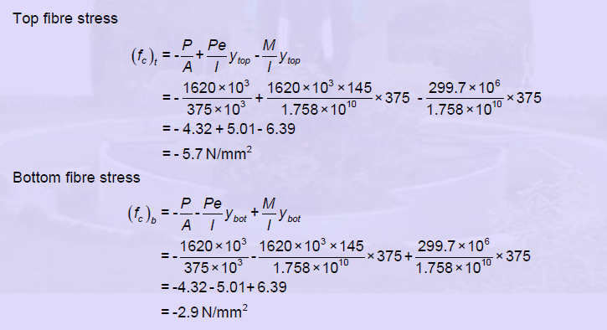

Slide 10
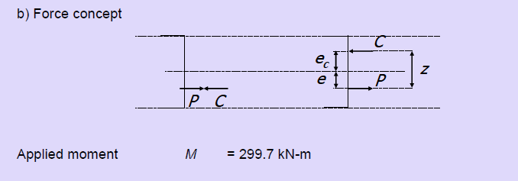
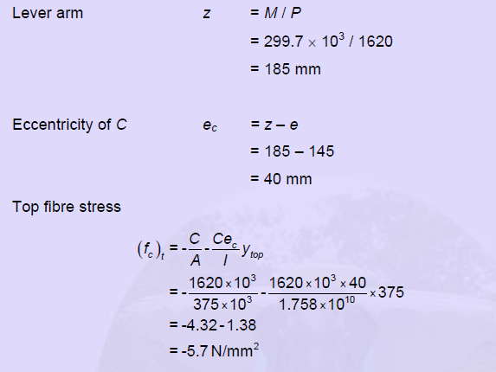

Slide 11
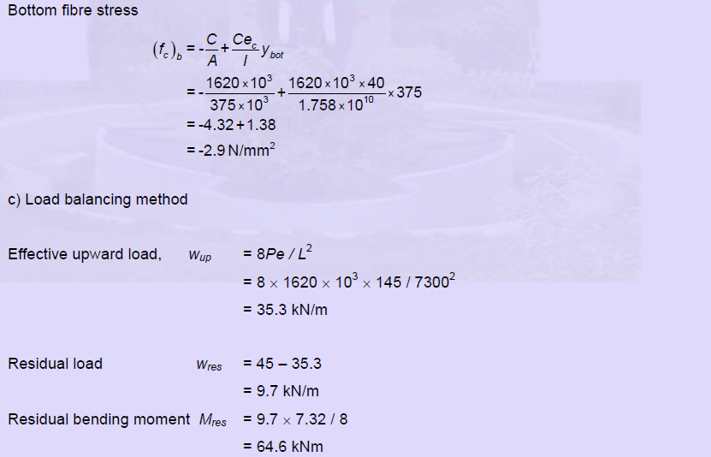

Slide 12
